Slide 1
How Much Do We Get Paid
Focus on Data Practitioners and factors influencing salary level and variations. Fomba Kassoh

Slide 2
Title and Introduction
Title: How Much Do Data Practitioners Get Paid?
Salary Insights: Role, Region, and Experience Analysis
Introduction: Analysis of salary trends in data science and tech, covering roles, experience levels, employment types, company size, and regional variations.
Data Sources:
Kaggle: Data Science Salaries 2024
BLS: Occupational Employment and Wage Statistics
Objective: Insights for Data Practitioners on factors influencing salary level and variations.

Slide 3
Analysis Summary
Scope: U.S. salary data across data practitioner roles, segmented by region, experience, job type, and company size.
Variables:
Experience: From entry-level (EN) to executive (EX).
Employment Types: Contract (CT), Freelance (FL), Part-time (PT), Full-time (FT).
Company Size: Small (S), Medium (M), Large (L).
Remote Work: 0%, 50%, or 100% remote.
Regions: Comparison across Northeast, West, Midwest, and South.

Slide 4
Analysis Summary
Scope: U.S. salary data across data practitioner roles, segmented by region, experience, job type, and company size.
Variables:
Experience: From entry-level (EN) to executive (EX).
Employment Types: Contract (CT), Freelance (FL), Part-time (PT), Full-time (FT).
Company Size: Small (S), Medium (M), Large (L).
Remote Work: 0%, 50%, or 100% remote.
Regions: Comparison across Northeast, West, Midwest, and South.

Slide 5
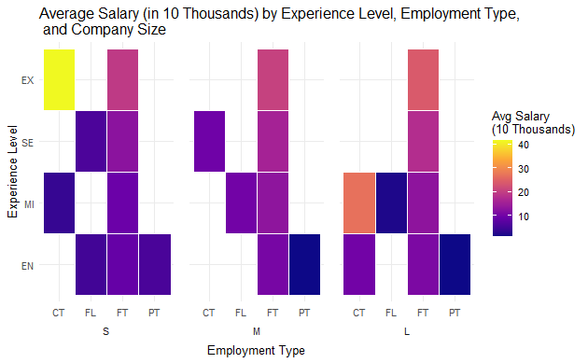
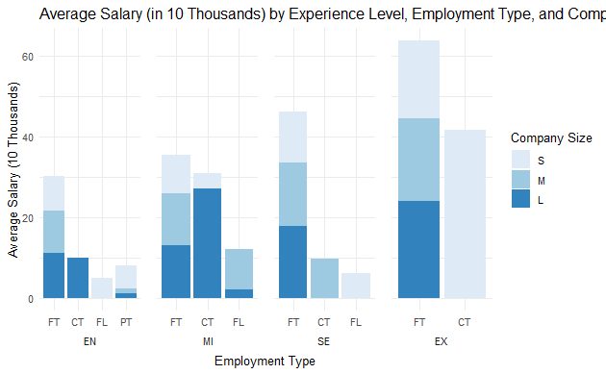
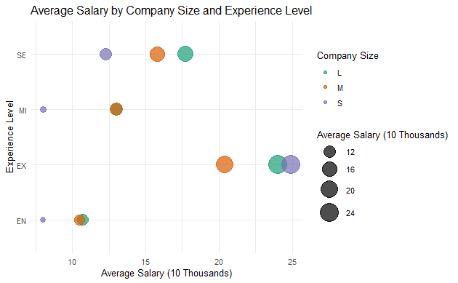
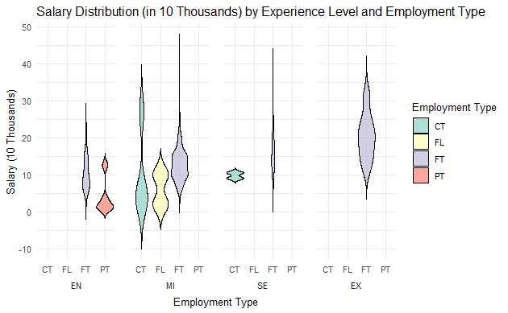
Salary Analysis by Experience, Employment Type, and Company Size
Larger companies and higher experience levels generally correspond with higher average salaries across employment types.

Slide 6
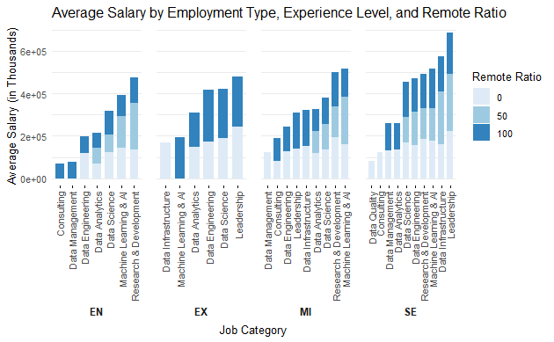
Salary Distribution Across Job Categories, Experience Levels, and Remote Ratio
Machine Learning & AI and Leadership roles consistently top salaries, especially for senior and executive levels with full remote flexibility.
Data Science roles also rank high, reflecting strong demand, with significant increases at senior levels.
Data Analyst positions generally show moderate salaries, with minimal increase across experience levels.
R&D roles offer competitive pay but remain more stable across experience levels compared to applied data science and AI roles.

Slide 7
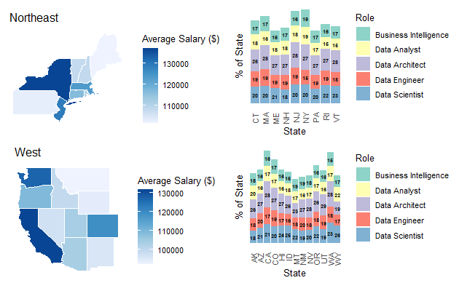
Regional Salary and Role Distribution (Northeast and West
Northeast and West regions show higher average salaries, particularly in states like California and New York.
Data Scientist and Data Engineer roles dominate salary distribution across states, especially in the Northeast.
Data Architect and Business Intelligence roles have consistent representation but at a lower salary range compared to Data Scientists.

Slide 8
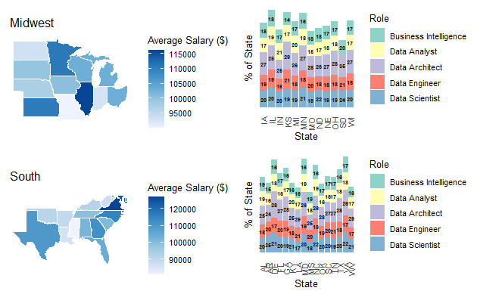
Regional Salary and Role Distribution (Midwest and South)
Midwest and South have lower average salaries compared to the Northeast and West, with a noticeable difference in states like Illinois and Texas.
Data Engineers and Data Scientists remain prominent across all regions but are generally paid less in the Midwest and South.
Data Analysts and Business Intelligence roles are consistent but typically represent a smaller portion of the salary distribution, especially in the South.

Slide 9
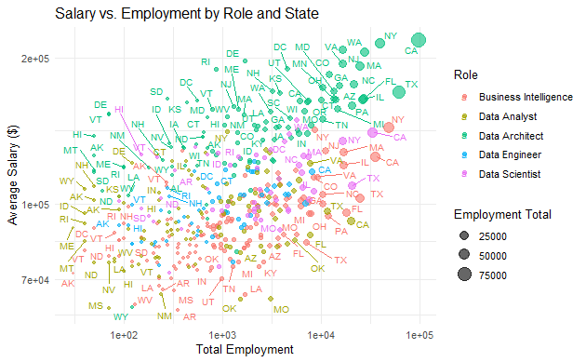
Salary and Employment Trends by Role and State
Positive Relationship
Higher employment associated with higher average salaries, especially for Data Scientists and Data Architects.
Role Concentration
High-salary roles like Data Scientist and Data Architect are prominent in states with high employment (e.g., CA, NY, TX).
State Variation
States like CA and NY have higher employment and salaries, while others, such as MS and WY, show lower values in both.

Slide 10
Key Highlights
Top-Paying Roles: Machine Learning & AI, Data Scientist, and Leadership, especially at senior levels.
Regional Insights:
Northeast and West: Higher average salaries, especially in states like California and New York.
Midwest and South: Lower average salaries, with competitive pay in Illinois and Texas.
Impact of Experience and Company Size: Higher experience and larger companies align with increased salaries.
Employment Types: Full-time roles generally pay more, with variability in freelance and contract roles.

Slide 11
Conclusion
Summary: Salary variations are influenced by experience, job type, company size, and region.
Takeaways:
Professionals should consider high-demand roles and regions for better pay.
Employers can use these insights for competitive salary offerings.
Future Considerations: Explore industry-specific variations and emerging tech impacts on salaries

Slide 12
References
Data Sources:
Kaggle: Data Science Salaries 2024
BLS: Occupational Employment and Wage Statistics
Tools Used: R (ggplot2, dplyr, gridExtra, tidytext, sf, tidyr) for data analysis and visualization.

